Slide 1

A. V. PAREKH TECHNICAL INSTITUTE
PC
VOICE
ASSISTANT

Slide 2
PROJECT MEMBERS
VATSAL BABARIYA - 176020307507
RAVI HARKHANI - 176020307524
NAMAN SOLANKI - 176020307555
PC VOICE ASSISTANT

Slide 3

RESPECTED GUIDE AND HOD
PROJECT GUIDE - Prof. D. S. Pathak
CE HOD - Prof. H. H. Rupareliya
PC VOICE ASSISTANT

Slide 4
ABSTRACT
The key here is voice. a voice assistant is a digital assistant that uses voice recognition, speech synthesis and natural language. This is a program that will listen to the voice of the user than it will work according to that query. pc voice assistant is useful to control windows, set alarm, events, web surfing, and sending e-mails to your colleagues.
PC VOICE ASSISTANT

Slide 5
FUNCTIONALITIES
Setup Reminder
Play Music
Open Youtube
Send E-Mail
Google Search
WikiPedia Support
Latest News Updates with Speak Option
PC VOICE ASSISTANT

Slide 6
CHARACTERISTICS
Easy to Understand GUI
User Friendly Application
Native Language Support
Daily Tasks Rapids Up
Easy to Control with Voice Support
PC VOICE ASSISTANT

Slide 7
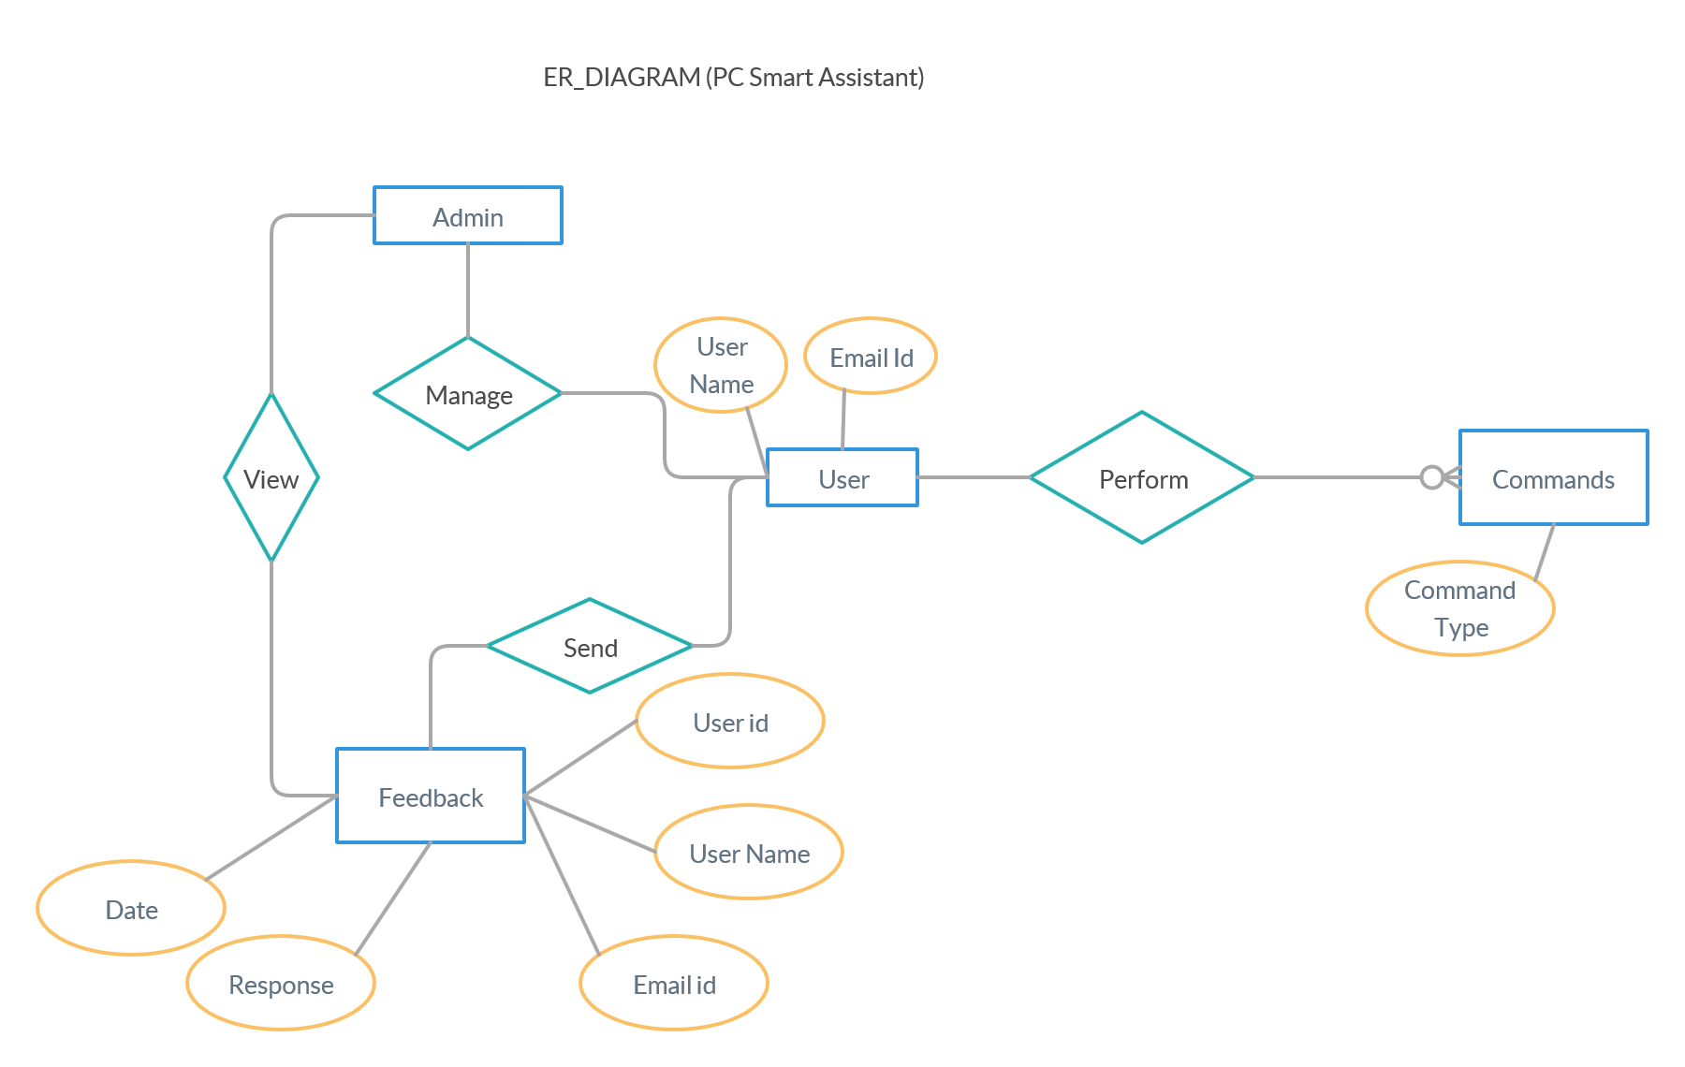
E-R DIAGRAM
PC VOICE ASSISTANT

Slide 8
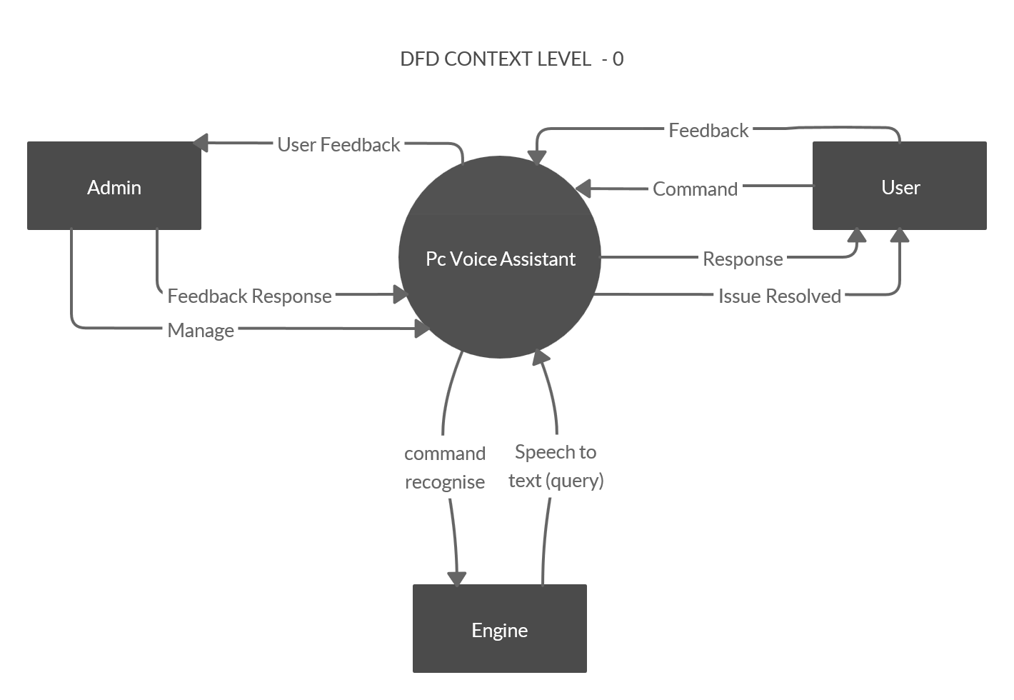
DATA FLOW CONTEXT-0 DIAGRAM
PC VOICE ASSISTANT

Slide 9
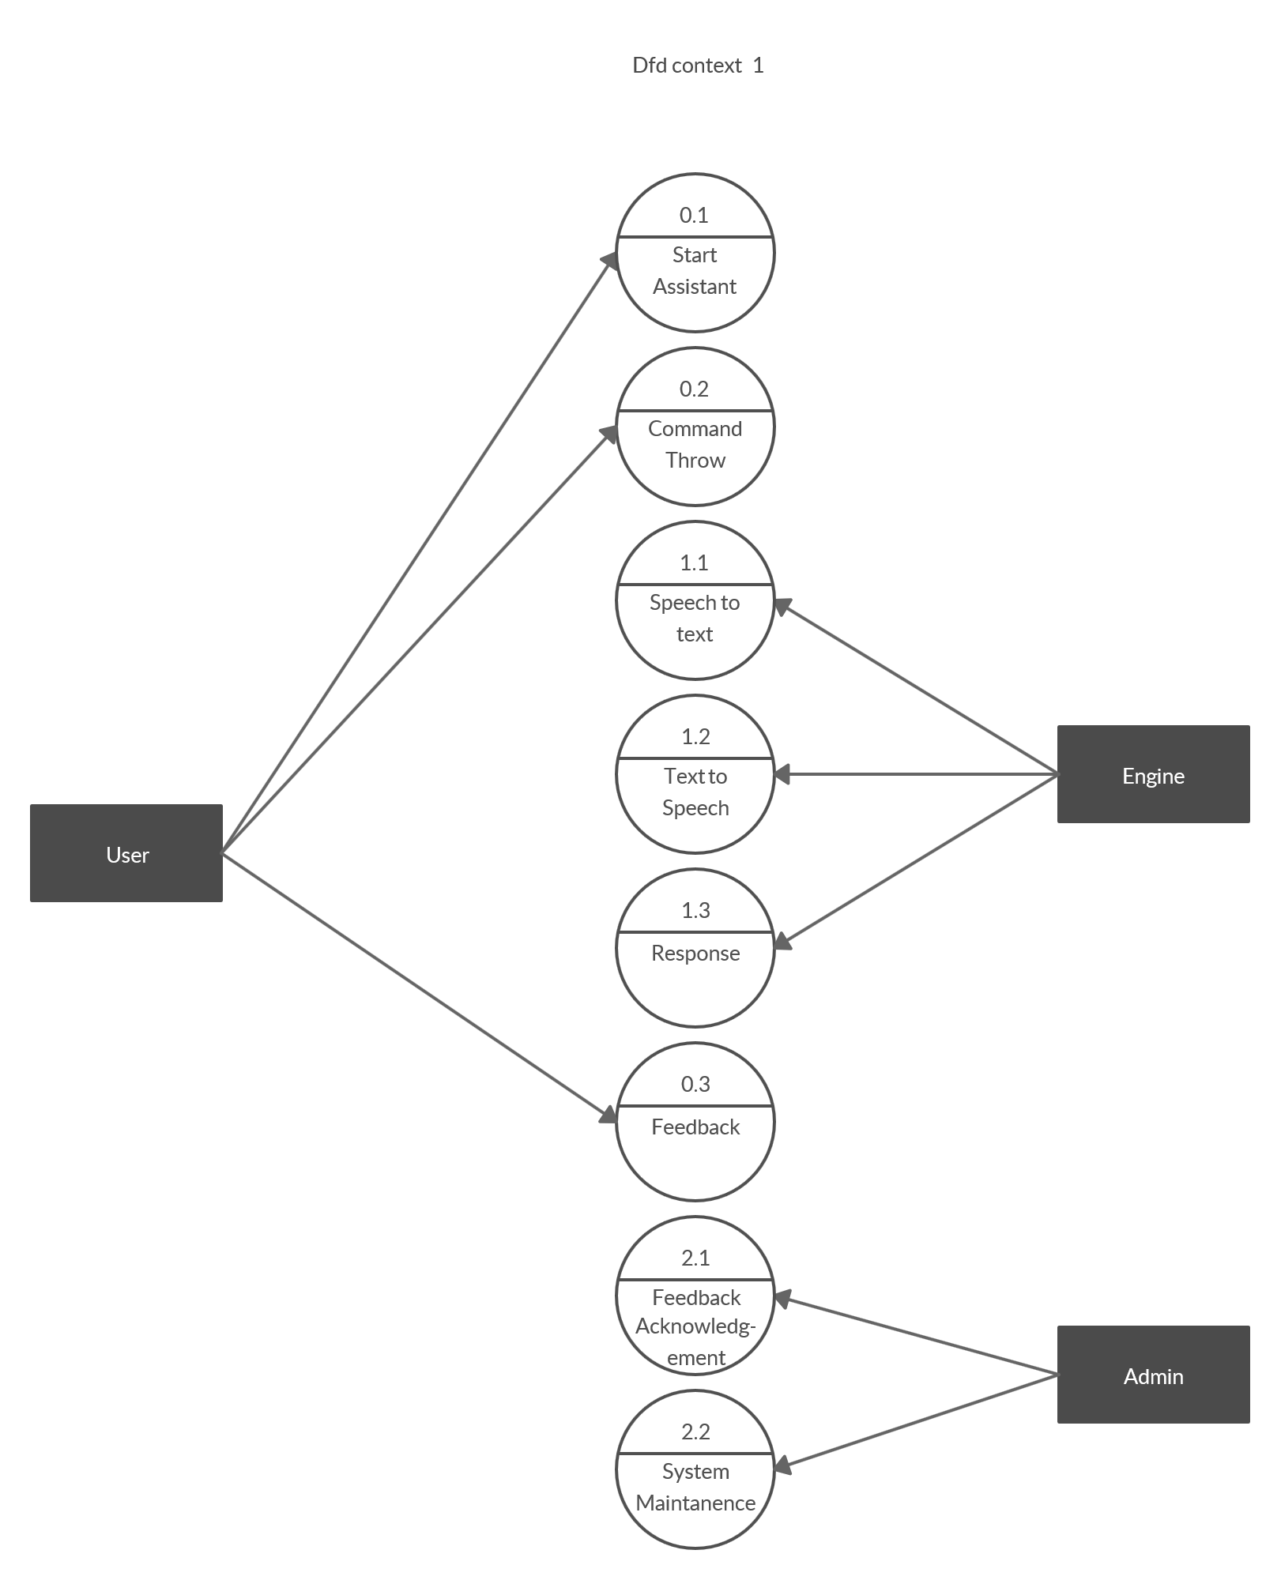
DATA FLOW CONTEXT-1 DIAGRAM
PC VOICE ASSISTANT

Slide 10
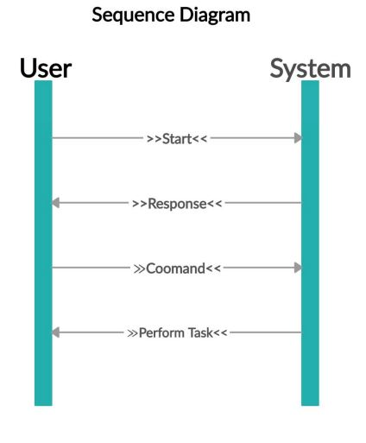
SEQUENCE DIAGRAM
PC VOICE ASSISTANT

Slide 11
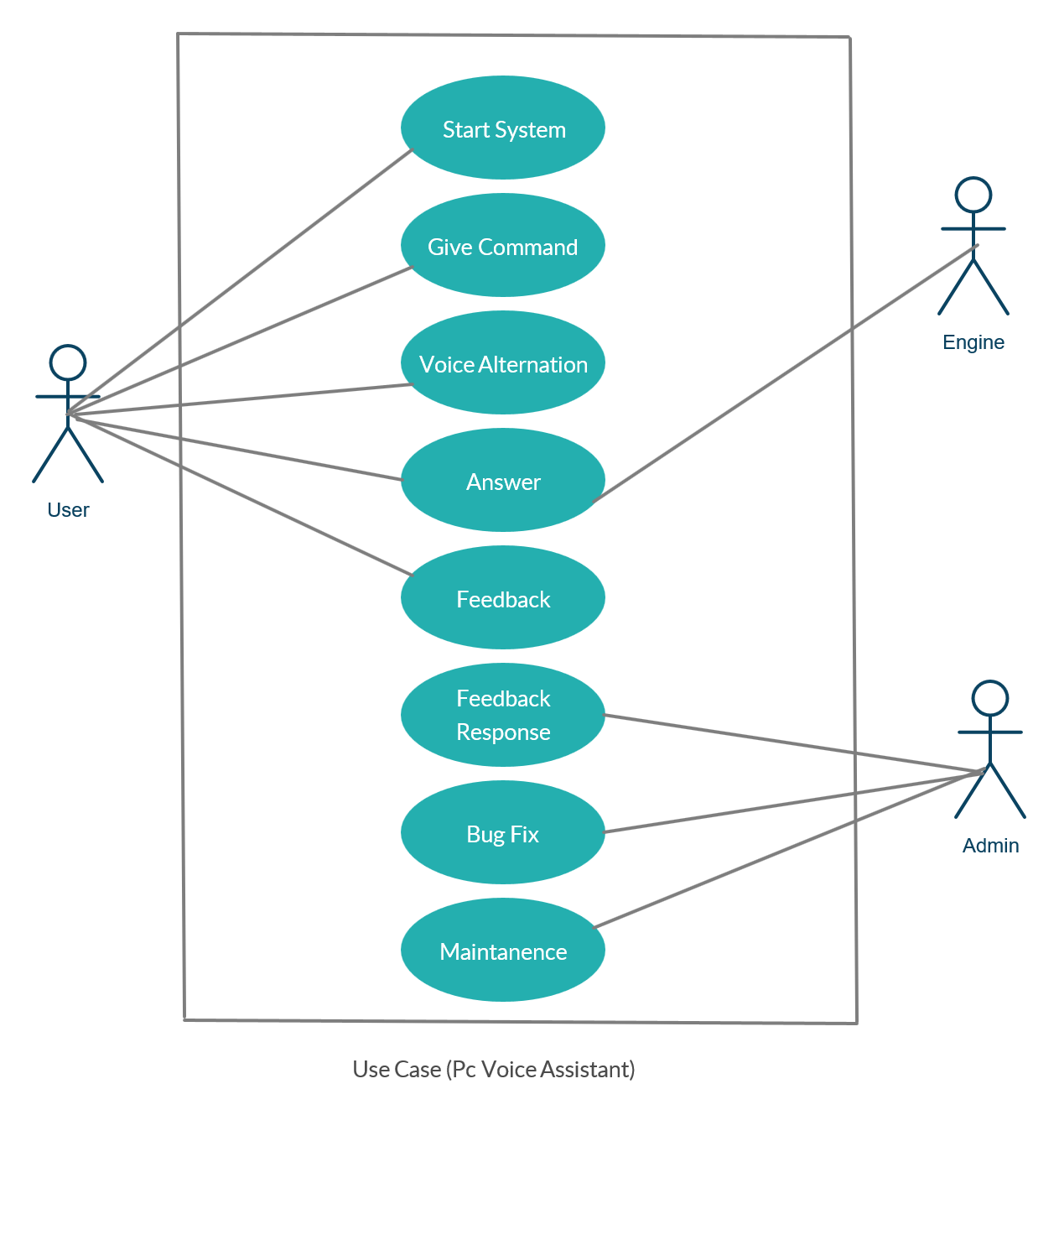
USE CASE DIAGRAM
PC VOICE ASSISTANT

Slide 12
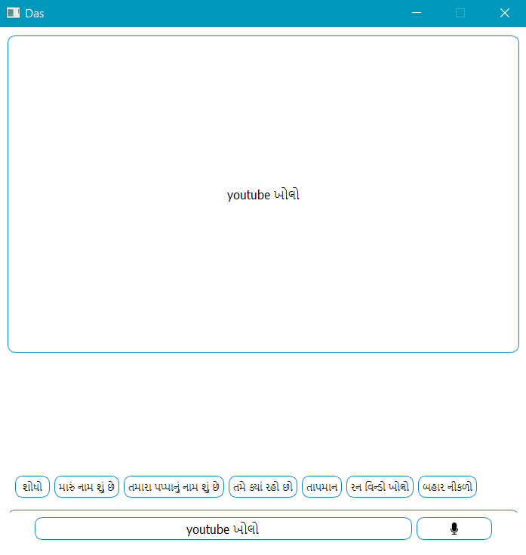
PREVIEW EXAMPLES & EXPLANATIONS
In this Preview example,
User asked
to open the
youtube .

Slide 13
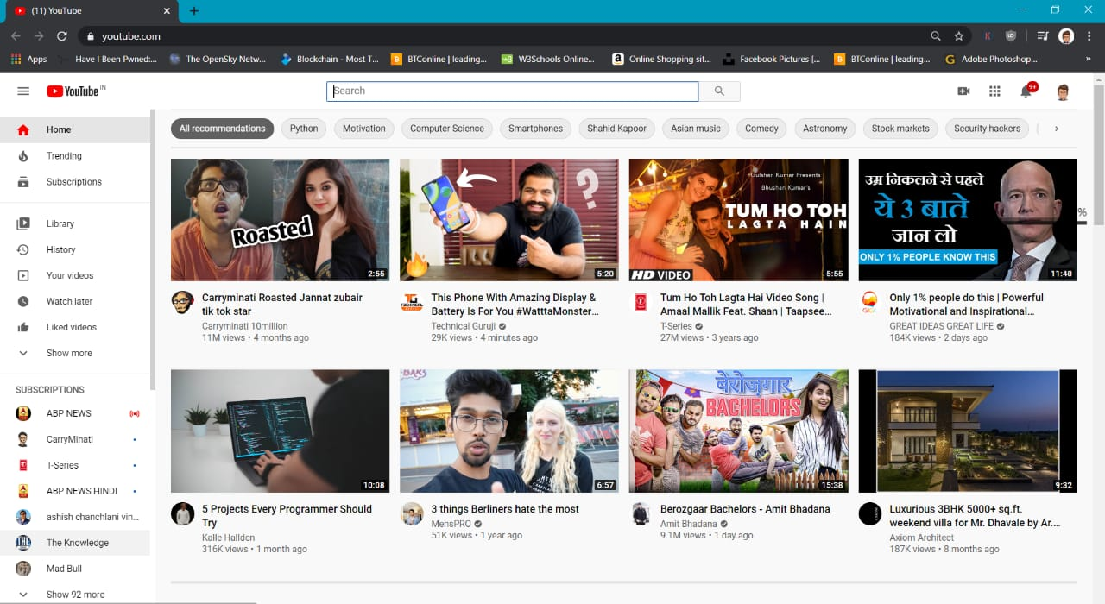
PREVIEW EXAMPLES & EXPLANATIONS
In this Preview example,
Open Youtube Command is Executed.
PC VOICE ASSISTANT

Slide 14
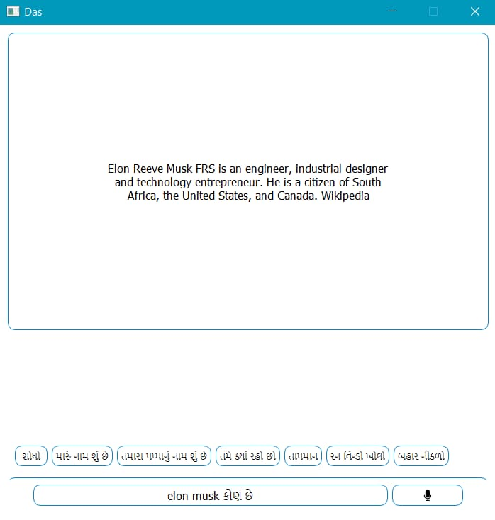
PREVIEW EXAMPLES & EXPLANATIONS
In this Preview example,
User Asked About Known Personality and Assistant Replied The Data About Personality using WikiPedia Library.
PC VOICE ASSISTANT

Slide 15
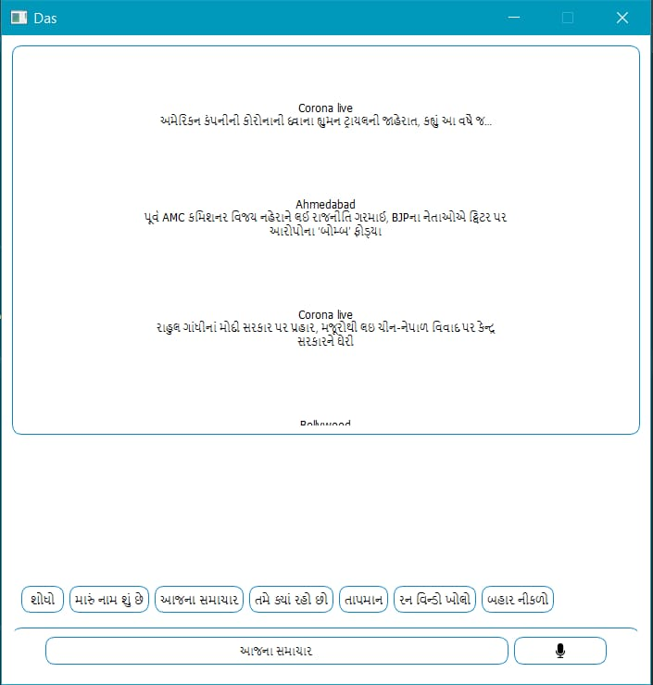
PREVIEW EXAMPLES & EXPLANATIONS
In this Preview example,
User Asked Updates about Today’s News, so Assistant Giving Updates and Reading the news at the same time.
PC VOICE ASSISTANT

Slide 16
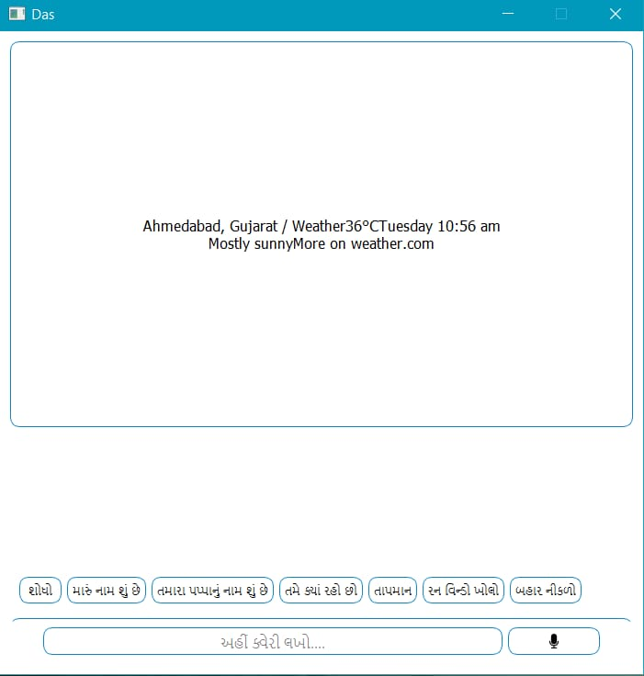
PREVIEW EXAMPLES & EXPLANATIONS
In this Preview example,
Assistant Giving Weather Updates with the time and day,date datas.
PC VOICE ASSISTANT

Slide 17
FUTURE SCOPE (improvement can be done)
Smart Home Project is Future Scope to Make it Work Like IOT
Farmers Can Find It Helpful with Farming With the Native Language Support
AI Can be Implement to Make it More personalise
PC VOICE ASSISTANT

Slide 18
TECHNOLOGIES USED
Python Version – Python 3.5
Code base Software – PyCharm Community Edition
Windows System – Windows 10
PC VOICE ASSISTANT

Slide 19
REFERENCES
Text Tutorials - https://www.simplifiedpython.net
Community support - https://stackoverflow.com
Library Details - https://pypi.org
Backend Video Lectures -
https://www.youtube.com/watch?v=aqvDTCpNRek&list=PLu0W_9lII9ag
ICnT8t4iYVSZ3eykIAOME
Gui Video Lecture -
https://www.youtube.com/watch?v=Vde5SH8e1OQ&list=PLzMcBGfZo4
-lB8MZfHPLTEHO9zJDDLpYj
PC VOICE ASSISTANT

Slide 20
Thank You.

